Slide 1


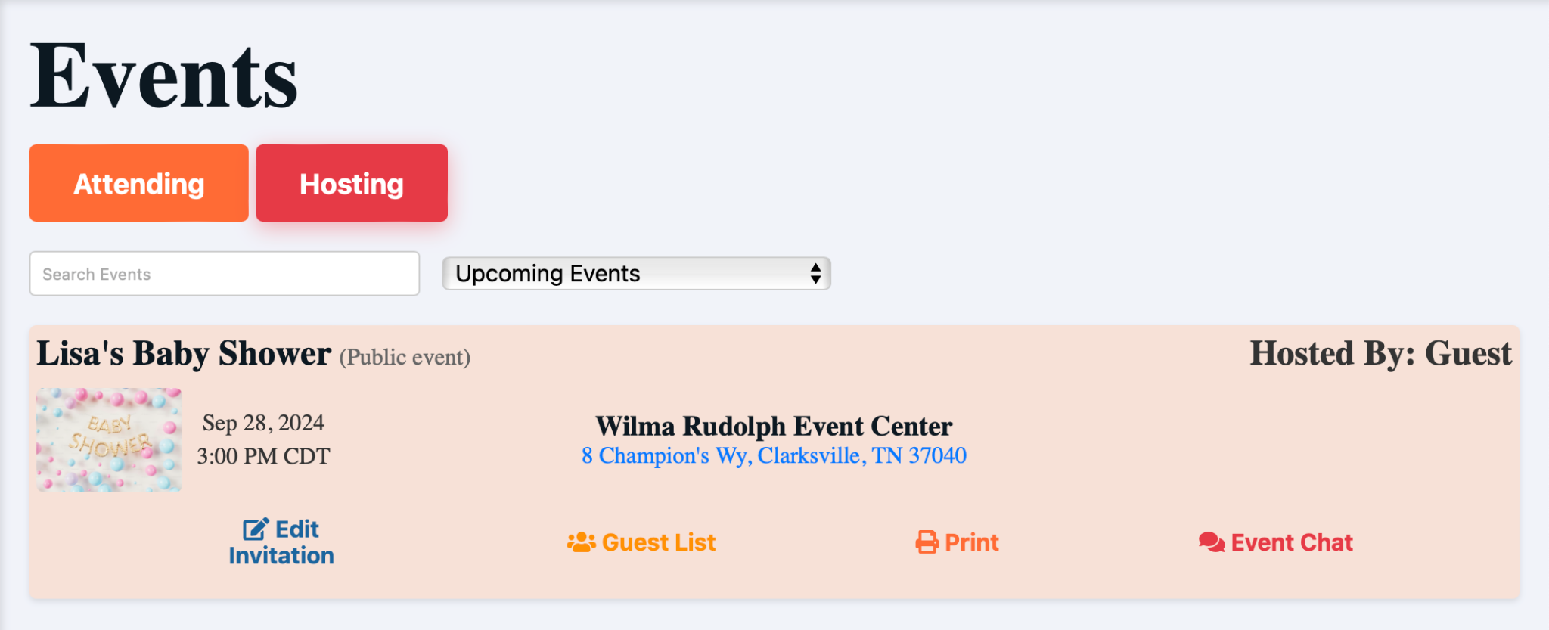
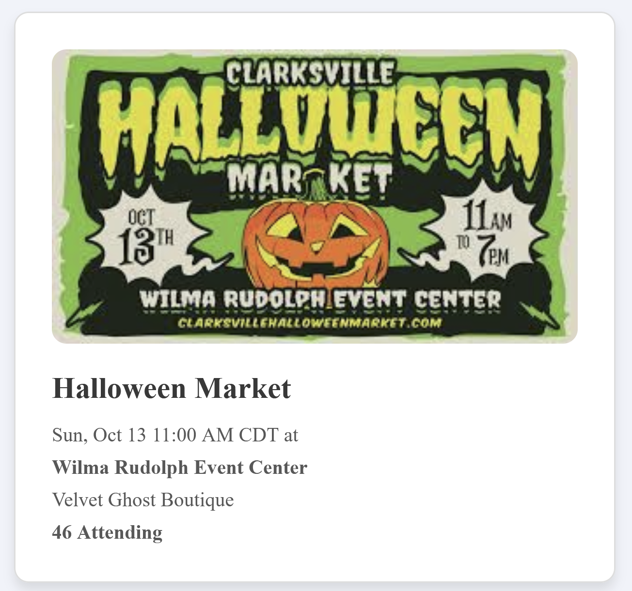
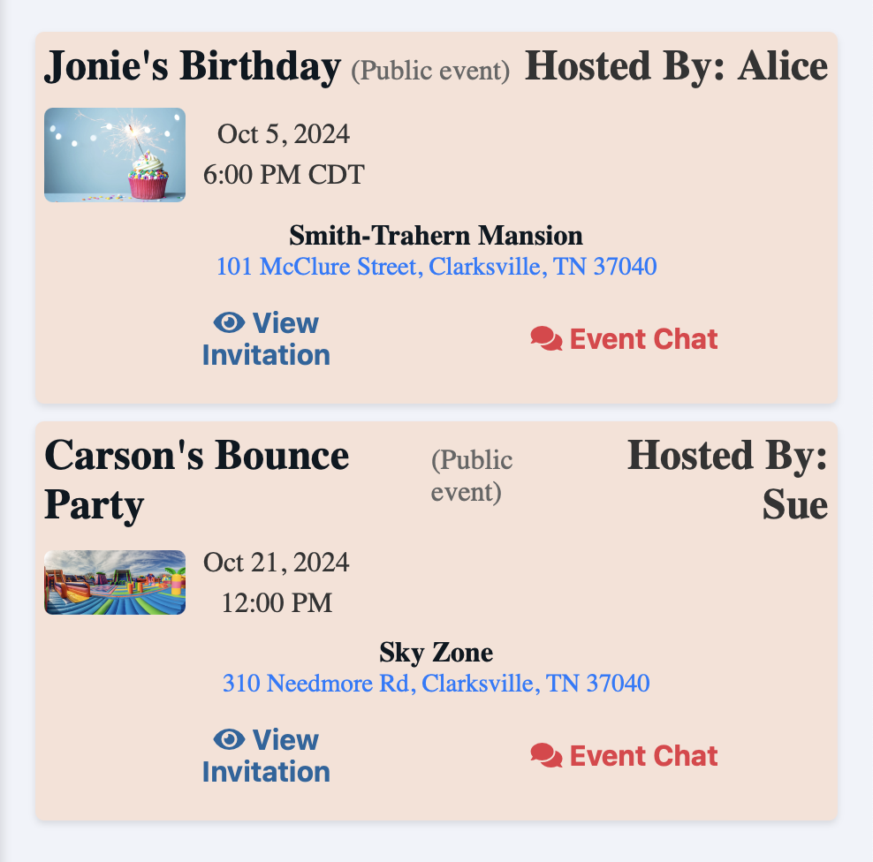
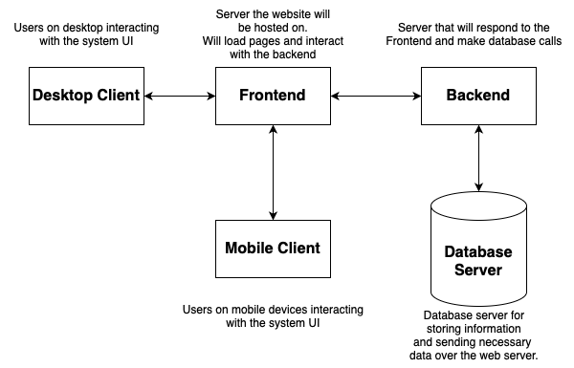
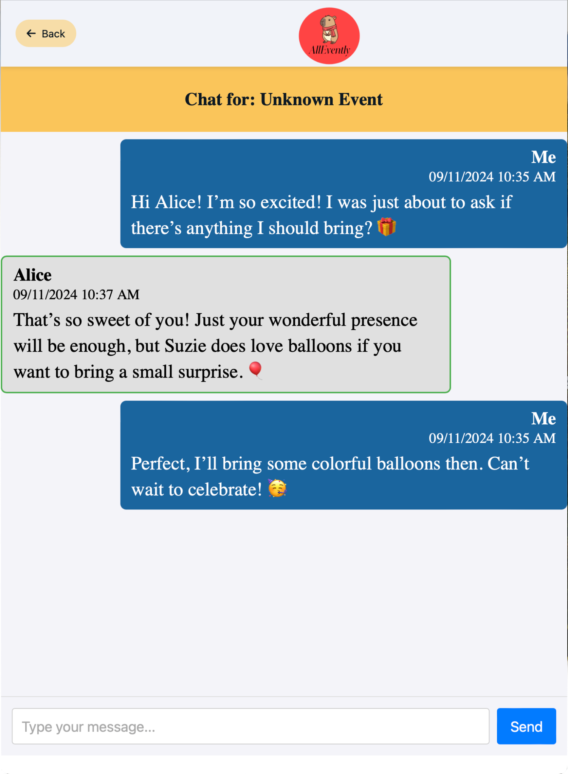
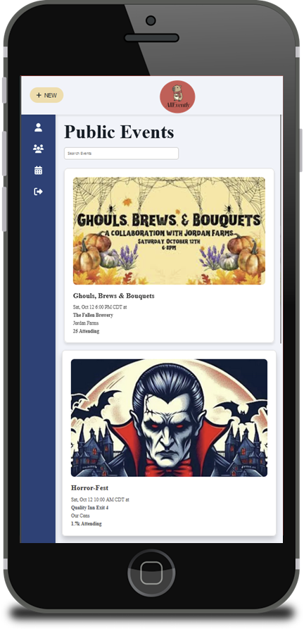
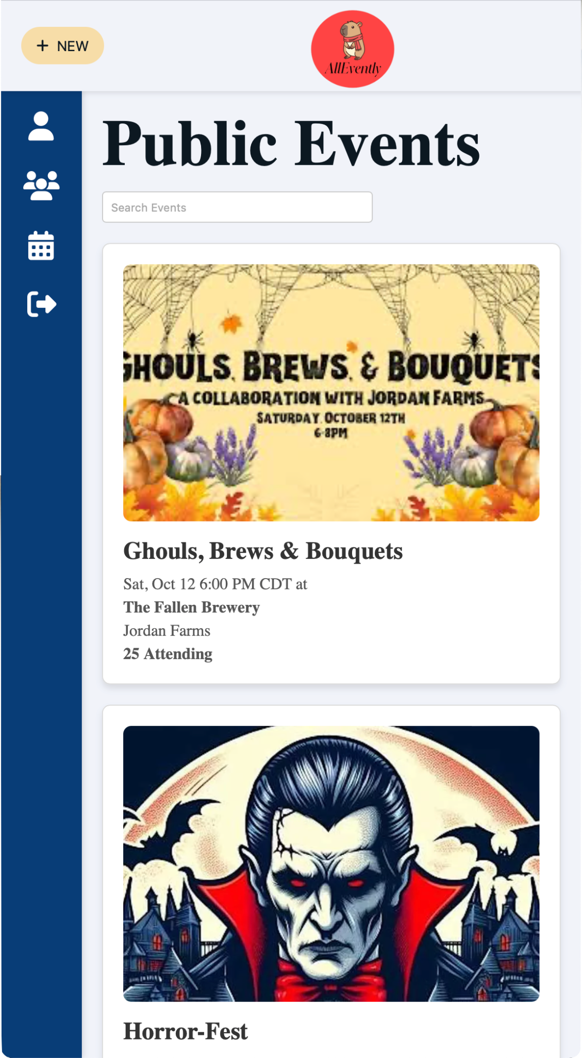
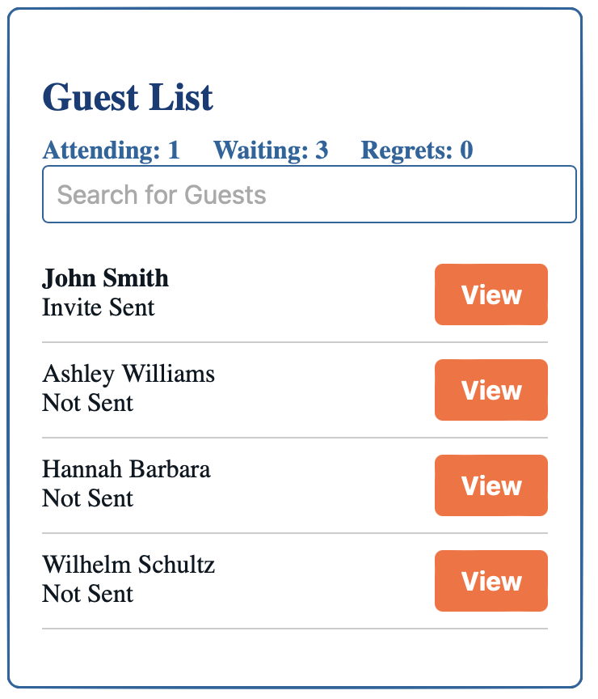
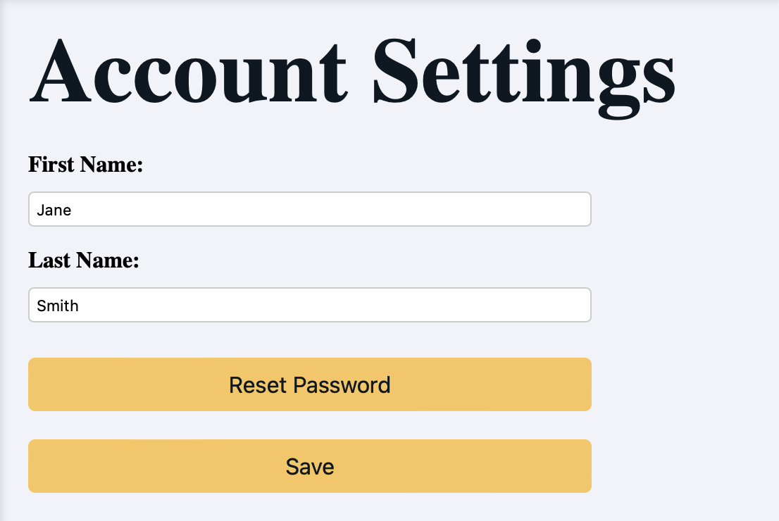
AllEvently
Benjamin Bruyns, Peggy Lewis, Spenser Morey
Dept. Of Computer Science and Information Technology
Abstract
AllEvently is a full-featured web application that streamlines event planning and management. It offers centralized event creation, management, and tracking, customizable invitations, real-time RSVP tracking, and integrated event chat.
Background
AllEvently is a web-based platform where users can create events where they specify the details such as suggested gifts, location, date, and time. It will provide a simplistic way for them to choose a style template and design their own custom invitation and send them.
Figure 1: The Events Page contains events that the user is hosting, and is separated by the hosting tab.
Figure 2: A detailed public event card.
Design
Technology
The website has a straightforward design that will provide users with the tools they need in an easily-understandable format. Sending custom invitations will just require the host to enter guest emails, and our website will handle the rest. There is also an event chat function that will be native to the website, and provides the attendees and host a way to contact all members without them having to leave the website and manually send countless emails.
The website is written with HTML, CSS, and TypeScript. Various frameworks such as Node.JS (framework for running JavaScript), Express.Js (a framework for server-side web development), Vue.js (front-end framework for developing user interface), PostgreSQL (a framework for developing a relational database), and Vercel (the server that AllEvently is hosted on) are all used to create the website.
Figure 3: This Block Diagram showing the Frontend server which delivers the webpages to the Clients. It also shows the Backend server which packages and delivers information from the Database Server to the Frontend.
Figure 4: The Events Page displays event cards summarizing details for events the user has been invited to. The events are organized under tabs based on the user’s attendance status, making it easy to navigate and interact with specific events.
Figure 8: Event chat to talk to the host and attendees.
References
Figure 5: Mobile view of the Public Events page, shows a list of upcoming events with event titles, images, and brief descriptions. The layout is designed for easy navigation, featuring a sidebar menu for quick access to other pages.
Figure 6: The Account Settings page interface, where users can update their personal information such as first and last names, and password.. The layout features a clean and simple design with clear action buttons to enhance usability.
Figure 7: The Guest List helps manage event attendees by allowing users to search for guests, track statuses ("Attending," "Waiting," "Regrets"), and view details for each entry. This streamlines organizing and monitoring participation.
Node.JS: https://nodejs.org/en
Express.JS: https://expressjs.com/
Vue.js: https://vuejs.org/
PostgreSQL: https://www.postgresql.org/
Vercel: https://vercel.com/

